Slide 1

Analysis Used Cars Dataset Using ML Models
By: Ambrish Choudhary

Slide 2
Problem Statement
The goal for this project is to build a Machine Learning models that could predict the price of a second-hand vehicle based on some of its specifications.
This model will then be evaluated on how well it predicts the actual prices.
This will also help in identifying the variables that directly influence the prices.

Slide 3
Data Analysis & Observations
The year in which the car was sold were range from 1953 to 2016.
The data set contains 87 distinct car values.
There are 267 rows with the price as zero.
There were some cars sold with mileage of zero indicating that the dealership sells new vehicles along with old ones. Also the outliers >900 are only 5 in number also there are other value surrounding it which inclines us more to think that these could not be outliers.
There are 434 null values in this engV which could be replaced with the median of the data.
The fuel type consumed by the engine have only 4 distinct values petrol, gas, diesel and other.
The model name has very high cardinality (888 unique values).
Only 4 possible values for drive type of the vehicle. There are 511 missing values and could be replaced with the mode of the data as this is categorical data.

Slide 4
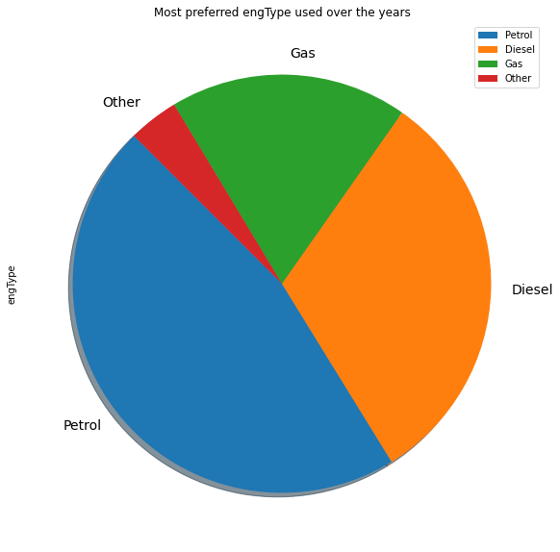
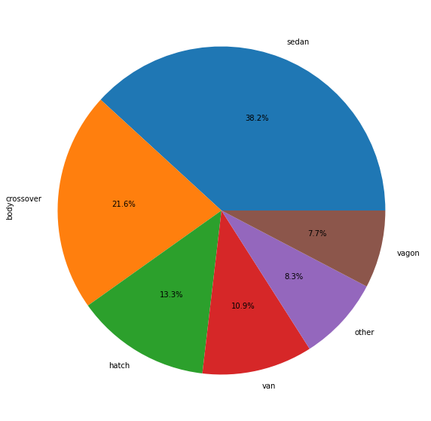
Sales Distribution - Engine Type & Body Type
This shows Petrol is the most preferred car.
Sedan(38.2%) is the highest sold body type followed by crossover(21.6%) and hatch(13.3%)

Slide 5
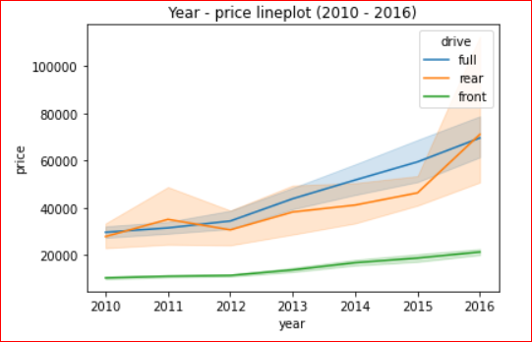
Price distribution over the years
The max number of cars sold by the total value was in 2016

Slide 6
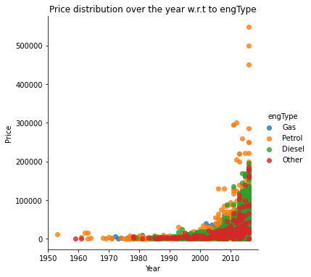
Price distribution by the years w.r.t. engType
As the years increase, there is significant increase in prices of cars models having engine type = "Petrol" as compared to "Gas" and "Diesel".
All the cars with production year 2010 or later sold in price more than 50000.
All the cars with production year before 2010 sold in price 50000 or lower.

Slide 7
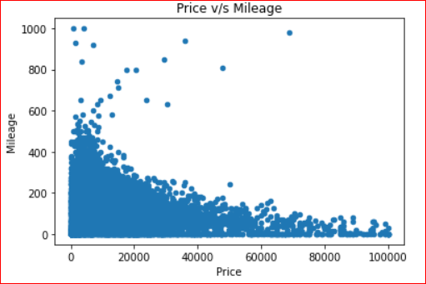
Price distribution by the years w.r.t. mileage
The above graph shows line plot/relation between mileage and price. We can't comment on the price increase/decrease over the mileage but this shows, price changing accordingly based on mileage value. So price is varying based on mileage too and this should be consider as a factor for the calculation.

Slide 8
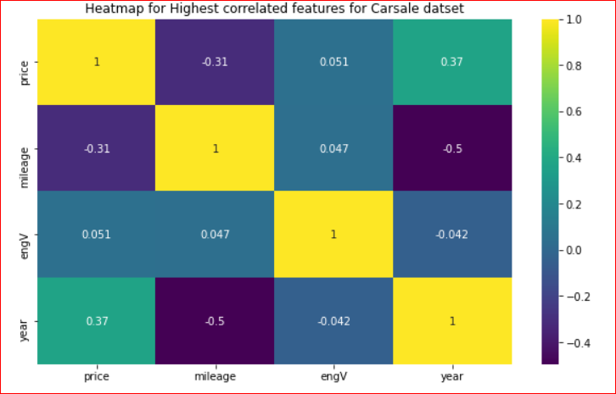
Heatmap – Correlation among different features
Production year has negative correlation with mileage and engine volume.
Engv and Mileage does not have weak correlation with price.

Slide 9
EDA Conclusion
We have observed that lower price segment car has higher mileage and higher price segment car has lower mileage.
Price and mileage have strongly negative correlation in sold car dataset
There is significant increase in prices of cars models having engine type "Petrol" as compared to "Gas" and "Diesel".
All the cars with production year 2010 or later sold in price more than 50000.
As the years increase, in general there has been an increase in price in recent years.
Petrol powered cars are sold the maximum.
Production year has negative correlation with mileage and engine volume.

Slide 10
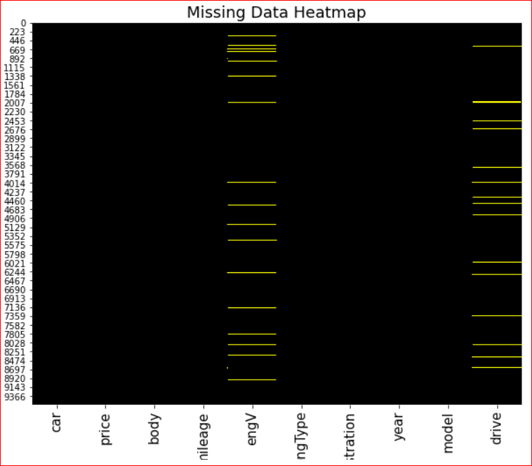
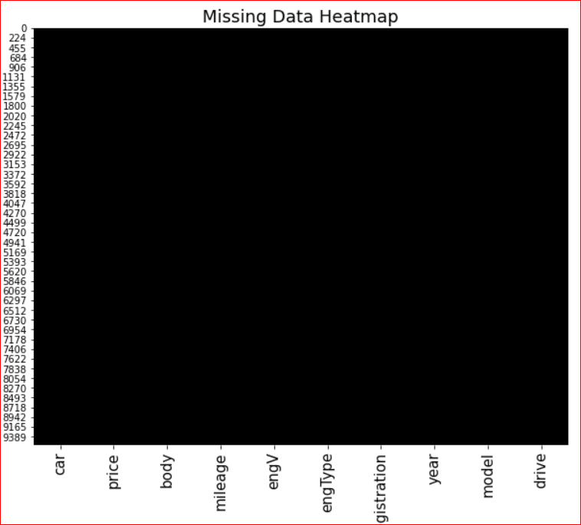
Data Cleanup and Data Pre Processing
Removed records having Null/Missing values. Also, removed duplicate records
Before
After

Slide 11
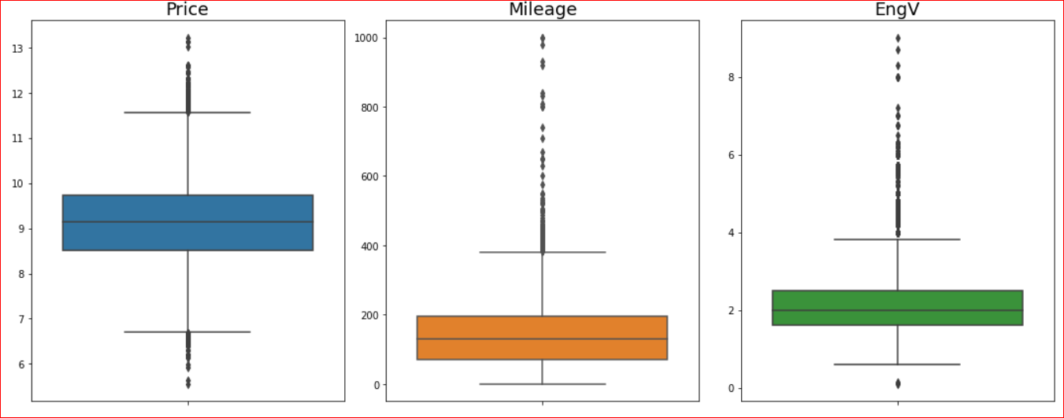
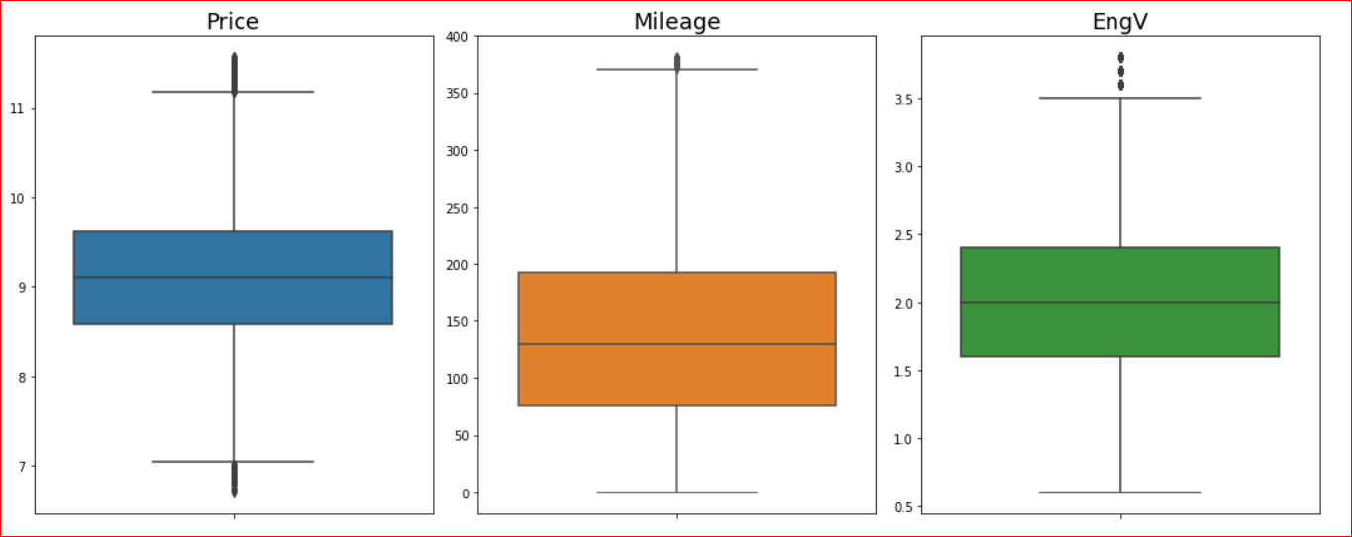
Data Cleanup and Data Pre Processing – Remove Outliers
Before
After

Slide 12
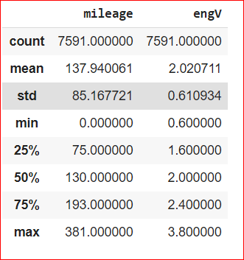
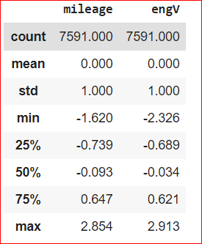
Feature Scaling
Before
After
Most of the Mileage values are in the hundreds, while the engV values are between 0 and 3.8. In order for our regression to treat these two features equally, we need to transform our data into a standard scale. Here I used the StandardScaler module from sklearn to do the standardization.

Slide 13
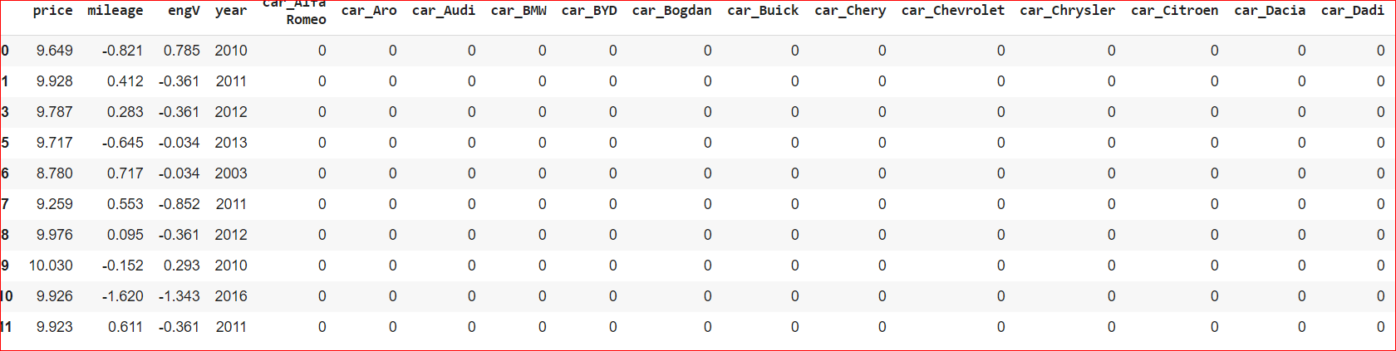
Generating Dummy Variables

Slide 14
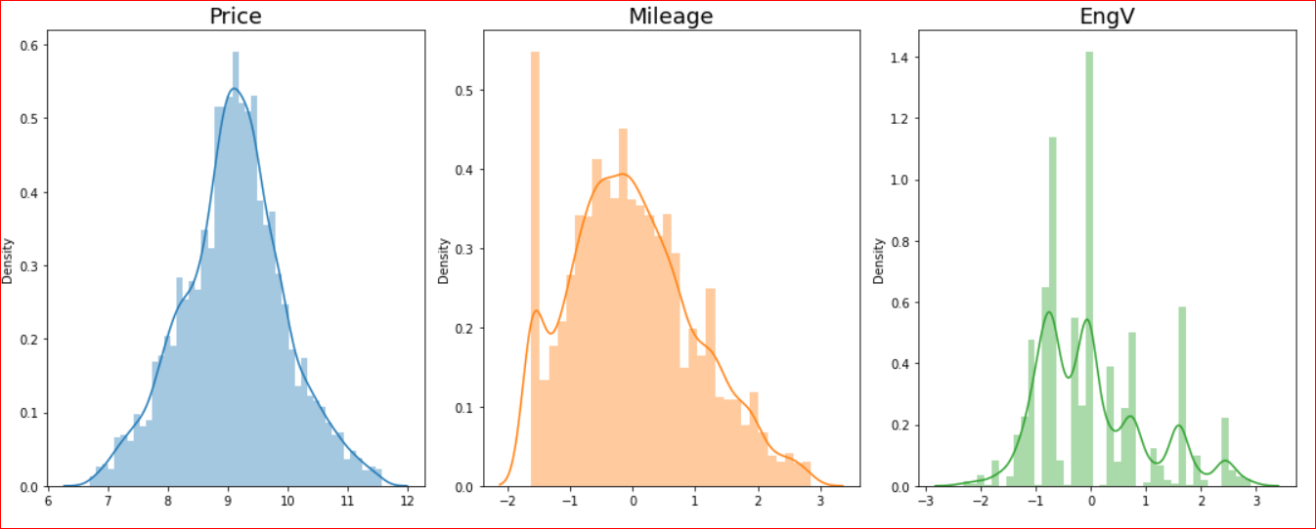
Distribution of Numeric data
Data is normally distributed so ready for ML model preparation

Slide 15
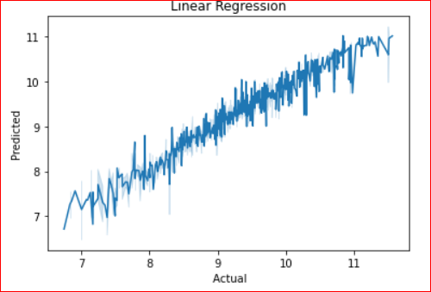
Linear Regression Model
We can see that R-square value is ~87%
MAE value is low which is ~20%
RMSE value is also low which is ~30%
Linear regression model performed quite well on dataset and able to predict with accuracy of ~87%

Slide 16
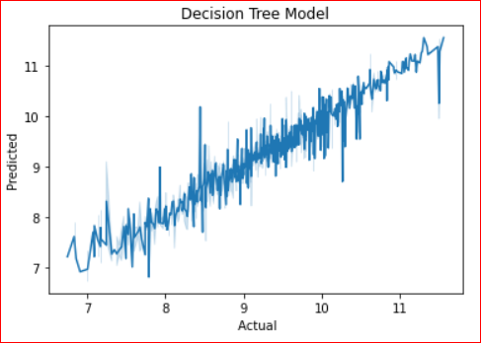
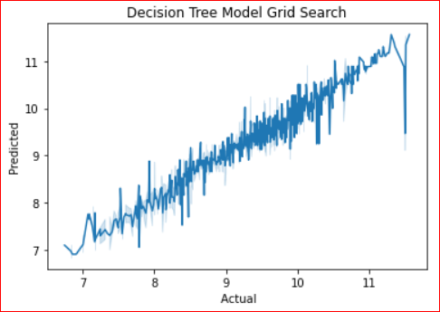
Decision Tree Model

Slide 17
Decision Tree Model
Decision tree model doing better than Decision tress Search CV model on this dataset.
We can see that R-square value > ~85%
MAE value is low which is < ~11%
RMSE value is also low which is ~18%

Slide 18
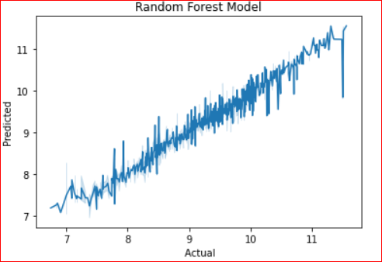
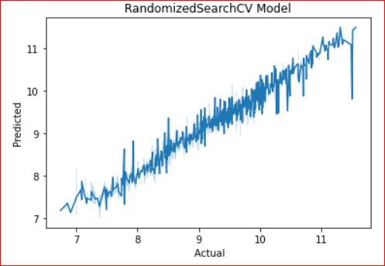
Random Forest Model

Slide 19
Random Forest Model
Random forest model doing better than Random forest Search CV model on this dataset.
We can see that R-square value > ~81%
MAE value is low which is < ~9%
RMSE value is also low which is ~14%

Slide 20
Conclusion
Since we're doing a multiple regressions, it makes much more sense to look at the Adjusted R-squared instead of the R-squared. In addition to the R-squared, the Adjusted R-squared values, and the Mean Absolute Error, I will also include the Root Mean Squared Error (RMSE) to help us evaluate our model. We'd want both the MAE and the RMSE to be as low as possible. So far, our numbers our telling us that we have a relatively good models. We trained these models with our train dataset and tested each models with our test dataset.
Our model performed similarly on test data as it did with the training data. There doesn't seem to be a major drop in performance based on the metrics we calculated (R-squared, Adj. R-squared, MAE, and RMSE).
To sum up, we have developed a total of 5 models under Linear Regression, Decision Tree and Random Forest. And Random Forest models performed better than other 4 models.

Slide 21
Thank You!

